Slide 1
An Introduction to Macroeconomics

Slide 2
Topics Covered
What is Macroeconomics
Macro Economic Goals
GPD
Modern Economic Growth
The Business Cycle
Employment
Inflation

Slide 3
Macroeconomics
Macroeconomics is the branch of economics that studies the behavior of the economy as a whole, including national income, employment, inflation, and government policies.
Contrasts with Microeconomics: Focuses on individual markets, consumer behavior, and firm behavior.

Slide 4
Macroeconomic Goals
1. Economic Growth
Economic growth refers to the sustained increase in the production of goods and services in an economy over time.
Economic growth leads to higher standards of living, increased employment opportunities, and improved living conditions for the population.
Factors Contributing to Growth: Investment in physical capital (such as machinery and infrastructure), technological progress, and development of human capital through education and training.

Slide 5
Macroeconomic Goals
2. Price Stability (Low Inflation)
Price stability refers to a low and stable rate of inflation, where prices of goods and services do not experience rapid or unpredictable changes.
Price stability is crucial for maintaining the purchasing power of individuals and businesses, promoting confidence in the economy, and facilitating long-term planning and investment decisions.
Effects of Inflation: Inflation erodes the purchasing power of money, distorts price signals, and can lead to income redistribution and uncertainty in economic transactions.

Slide 6
Macroeconomic Goals
3. Full Employment
Occurs when all available resources, particularly labor, are utilized efficiently in the economy, leading to minimal involuntary unemployment.
Types of Unemployment:
Frictional Unemployment: Temporary unemployment due to transitions between jobs or entering the workforce.
Structural Unemployment: Unemployment caused by a mismatch between the skills demanded by employers and the skills possessed by workers.
Cyclical Unemployment: Unemployment resulting from fluctuations in economic activity, such as during recessions.
Promotes economic stability, reduces social and economic disparities, and contributes to overall economic prosperity by maximizing productive capacity.

Slide 7
Purpose of Macroeconomic Measures
Economic Monitoring: Macroeconomic indicators like GDP and the unemployment rate are used to monitor economic performance, trends, and fluctuations over time.
Policy Formulation: Governments, central banks, and policymakers rely on macroeconomic data to formulate and assess the effectiveness of economic policies, such as fiscal stimulus, monetary interventions, and labor market regulations.
Business Decision-Making: Businesses and investors use macroeconomic measures to evaluate market conditions, assess risks, and make strategic decisions related to production, investment, hiring, and pricing.

Slide 8
Gross Domestic Product
Measure of aggregate output
Monetary measure
Avoid multiple counting
Market value final goods
Ignore intermediate goods
Count value added

Slide 9
Gross Domestic Product
Exclude financial transactions
Public transfer payments
Private transfer payments
Stock (and bond) market transactions
Exclude second hand sales
Sell used car to a friend

Slide 10
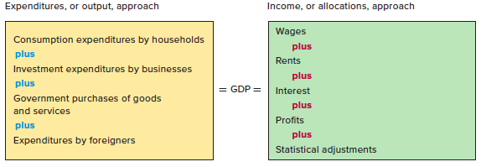
Two Approaches to GDP

Slide 11
Two Approaches to GDP
Income approach
Count income derived from production
Wages, rental income, interest income, profit
Expenditure approach
Count sum of money spent buying the final goods
Who buys the goods?

Slide 12
Expenditure VS Income Approach
In Billions
Receipts
Expenditures Approach
Allocations
Income Approach
Compensation
Rents
Interest
Proprietor’s Income
Corporate Profits
Taxes on Production and Imports
National Income
Net Foreign Factor Income (-)
Statistical Discrepancy (+)
Consumption of Fixed Capital (+)
Gross Domestic Product
$10,089
1628
2931
-392
$ 14,256
$ 7792
268
788
1041
1309
1090
$12,288
105
209
1864
$ 14,256
Personal Consumption (C)
Gross Private Domestic Investment (I_{g})
Government Purchases (G)
Net Exports (X_{n})
Gross Domestic Product

Slide 13
Nominal vs. Real GDP
GDP is a dollar measure of production
Using dollar values creates problems
Nominal GDP (Unadjusted)
Use prevailing price
Real GDP (Adjusted)
Reflect changes in price
Use base year price

Slide 14
GDP Price Index
Use price index to determine real GDP
Price
Index
in Given
Year
Price of Market Basket
in Specific Year
=
x
100
Price of Same Basket
in Base Year
Nominal GDP
Real
GDP
=
Price Index (in hundredths)

Slide 15
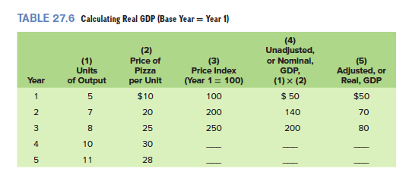
Calculating Real GDP

Slide 16
Modern Economic Growth
Standard of living measured by output per person
No growth in living standards prior to Industrial Revolution
Modern economic growth
Output per person rises
Not experienced by all countries
Per capita income stood at US$1,568 as compared to US$ 1,765 last year (Pak)

Slide 17
Some Stats
Output growth
3.4% global growth in 2022
real GDP posted a growth of 0.29% in FY2023 (Pak)
Unemployment rate
unemployment rate 6.3% (Pak)
Inflation rate
Global inflation 8.7% in 2022
29.2% during Jul-May, FY 2023 (Pak)

Slide 18
Determinants of Growth
Supply factors Increases in quantity and quality of natural resources Increases in quality and quantity of human resources Increases in the supply (or stock) of capital goods Improvements in technology | Demand factor Households, businesses, and government must purchase the economy’s expanding output Efficiency factor Must achieve economic efficiency and full employment
The supply, demand, and efficiency factors in economic growth are related. Change in one impacts on others.

Slide 19
The Business Cycle
Alternating increases and decreases in economic activity over time.
Peak
Peak
Trend
Peak
Level of real output
Growth
Expansion
Recession
Expansion
Trough
Recession
Trough
Time

Slide 20
Causation: A First Glance
Business cycle fluctuations
Economic shocks
unexpected events that individuals and firms may have trouble adjusting to.
Short-run price stickiness
prevents the economy from rapidly adjusting to shocks
Sources of shocks:
Irregular innovation
Productivity changes
Monetary factors
Political events
Financial instability

Slide 21
Measurement of Unemployment
The U.S. Bureau of Labor Statistics (BLS) divided the population into three groups:
People under 16 years of age and people who are institutionalized
“Not in labor force,”: potential workers but are not employed and are not seeking work
Labor force
Unemployment rate =
# of unemployed
labor force
X 100

Slide 22
Measurement of Unemployment
Under 16
and/or Institutionalized (71.4 million)
Unemployment rate =
# of unemployed
labor force
X 100
Not in
labor
force
(81.7 million)
Total population (307.3 million)
Unemployment rate =
14,265,000
154,142,000
X 100 = 9.3%
Employed
(139.9 million)
Labor force (154.2 million)
Unemployed
(14.3 million)

Slide 23
Economic Cost of Unemployment
Economy is “fully employed” when it is experiencing only frictional and structural unemployment.
Full employment occurs when there is no cyclical unemployment.
GDP Gap
GDP gap = actual GDP – potential GDP
Can be negative or positive
Okun’s Law
Every 1% of cyclical unemployment creates a 2% GDP gap

Slide 24
Noneconomic Costs
Loss of skills and loss of self-respect
Plummeting morale
Family disintegration
Poverty and reduced hope
Heightened racial and ethnic tensions
Suicide, homicide, fatal heart attacks, mental illness
Can lead to violent social and political change

Slide 25
Inflation
General rise in the price level
Inflation reduces the “purchasing power” of money
Consumer Price Index (CPI)
Price of the Most Recent Market
Basket in the Particular Year
CPI
=
x
100
Price estimate of the Market
Basket in Base Year
207.3 - 201.6
x
CPI
=
100
= 2.8%
201.6

Slide 26
Types of Inflation
Demand-Pull inflation
When total spending exceeds the economy’s ability to provide goods and services at the existing price level;
Total spending pulls the price level upward.
Central bank issues too much money
Cost-Push inflation
When factors such as rapid increases in the prices of imported raw materials drive up per-unit production costs at each level of output;
higher costs push the price level upward.

Slide 27
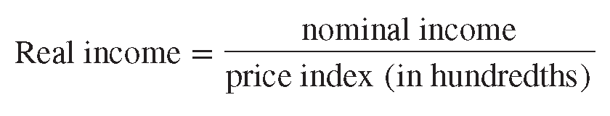
Redistribution Effects of Inflation
Nominal income
Unadjusted for inflation
Real income
Nominal income adjusted for inflation
If nominal income rises by 10 percent from $100 to $110 and the price level (index) rises by 6 percent from 100 to 106, then calculate the real income.

Slide 28
Who is Hurt by Inflation?
Fixed-income receivers
Real incomes fall
Savers
Value of accumulated savings deteriorates
Creditors
Lenders get paid back in “cheaper dollars”

Slide 29
Who is Unaffected by Inflation?
Flexible-income receivers
Cost-of-living adjustments (COLAs)
Social Security recipients
Union members
Debtors
Pay back the loan with “cheaper dollars”

